Slide 1
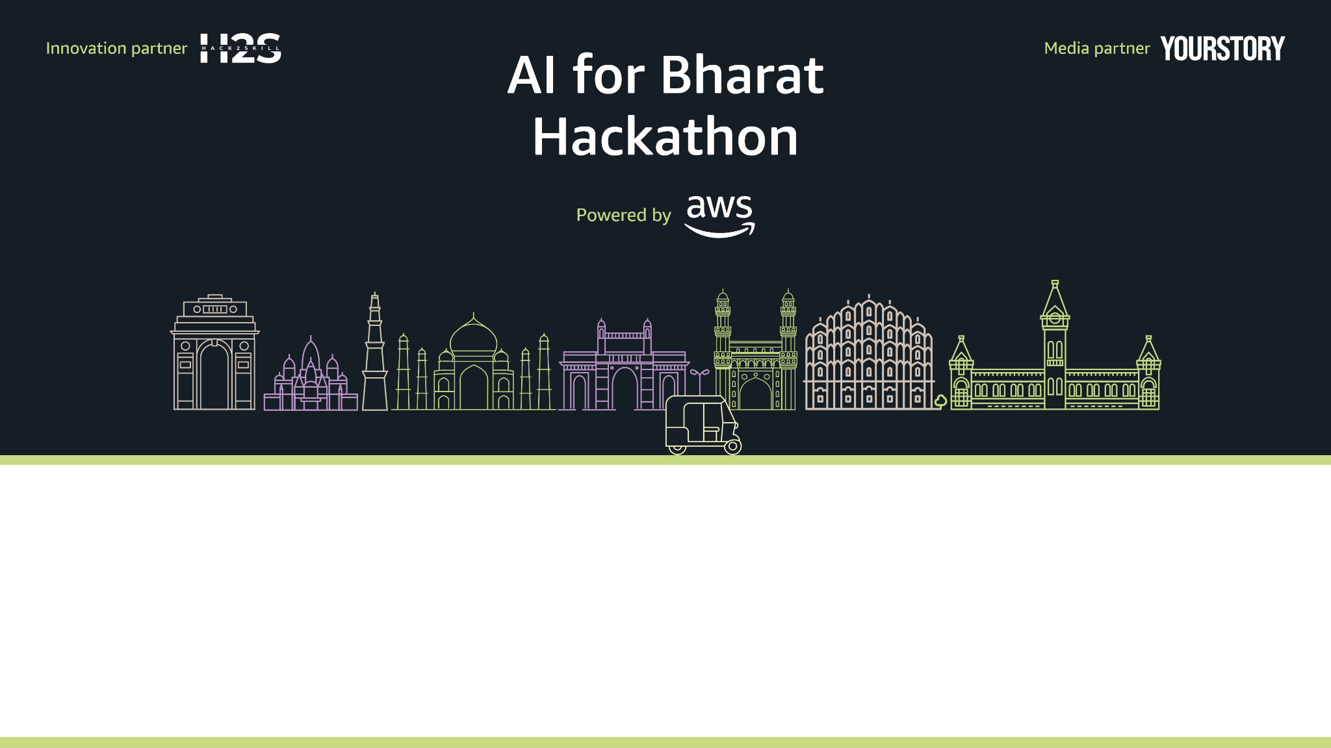
WB Digital Sahayak
Voice-First Welfare Eligibility Engine for West Bengal
Team Name: Team Web
Team Leader Name: Souvik Karmakar
Problem Statement: Overcoming the digital and literacy barriers preventing millions in West Bengal from accessing ₹25,000+ crores in annual welfare benefits due to complex rules and high "failed visit" costs.

Slide 2
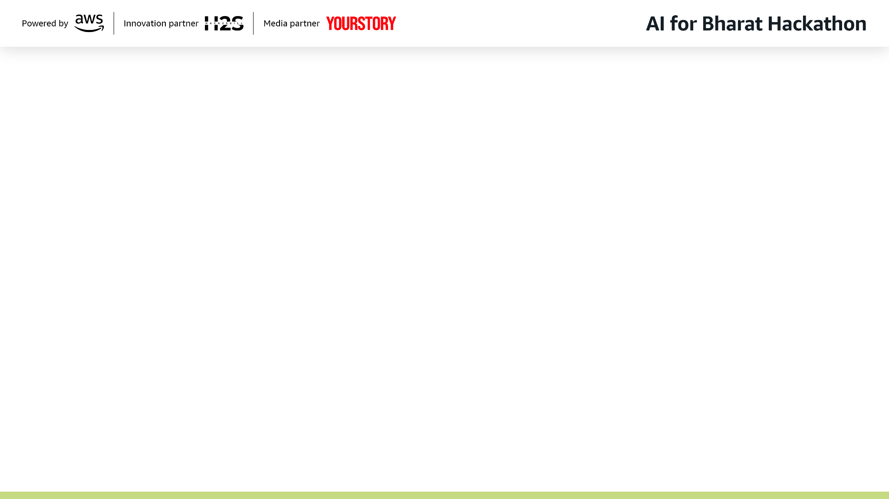

Brief about the Idea
WB Digital Sahayak is a voice-first, AI-driven unified eligibility engine designed for the citizens of West Bengal. It acts as a "Digital Friend" (Sahayak) that allows users to:
Interact via Voice: Use native Bengali to ask about schemes.
MVP Focus: Lakshmir Bhandar (architecture supports multi-scheme)
Readiness Focus: Moves beyond simple "Yes/No" answers to provide a roadmap for successful application.

Slide 3
Solution Context & Winning POV
How different is it from existing ideas?
How will it solve the problem?
USP of the proposed solution
Existing portals are text-heavy, English-centric, and require high digital literacy. Our solution is Voice-First and Deterministic. We don't just "chat"; we calculate.
By providing a Readiness Score, it ensures citizens only visit government offices when they are 100% prepared. This eliminates the ₹50 per-visit travel waste for rural families.
Zero-Hallucination Guardrails: Logic-based eligibility verification paired with AI-based explanations.
Planned Feature: Cross-scheme suggestions (e.g., eligible for Lakshmir Bhandar → suggest Kanyashree if has daughter)

Slide 4

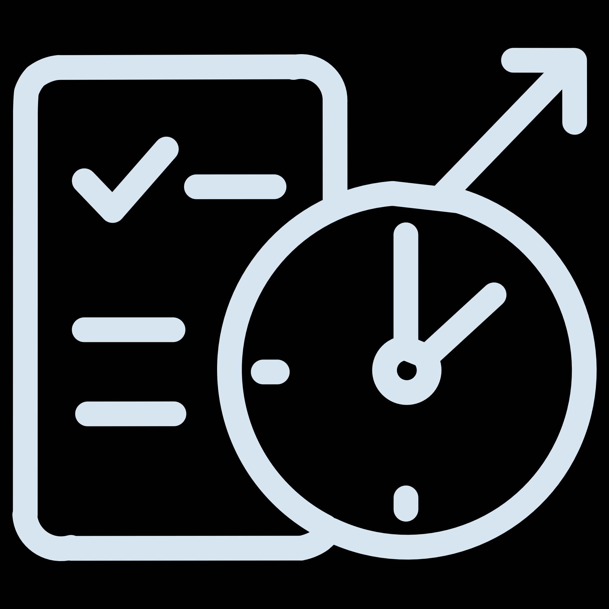





List of Features
Deterministic Eligibility Engine
Rules-based logic for verified accuracy.
Readiness Score (0–100%)
Real-time feedback on application maturity.
Missing Document Identification
Lists exactly what is needed (e.g., "Aadhaar not linked").
Voice-First Interface
Powered by Sarvam AI for natural Bengali interaction.
Proactive Renewal Alerts
Automated WhatsApp/Voice reminders for expiring benefits.
Multi-Channel Access
Works on low-end smartphones via WhatsApp and Web.

Slide 5
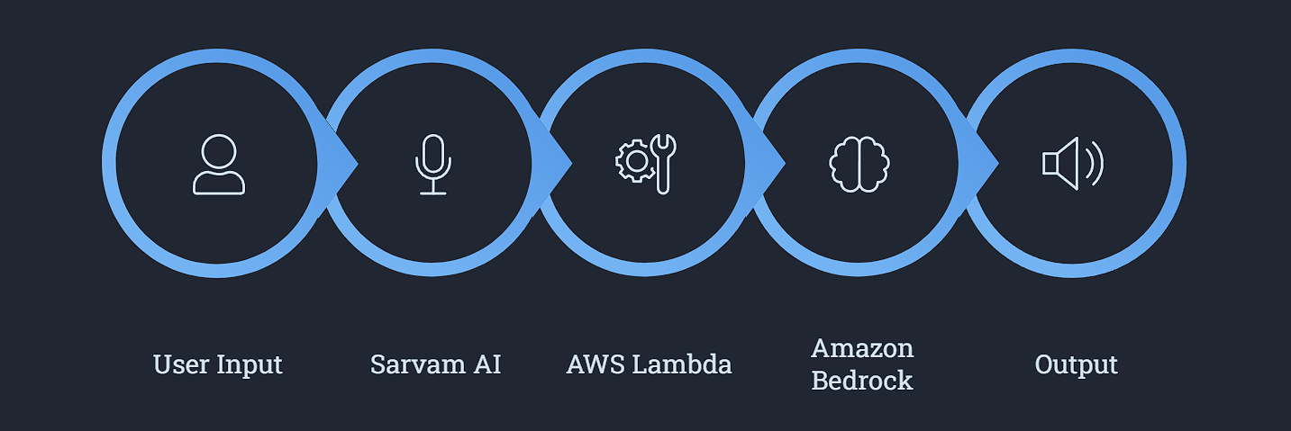


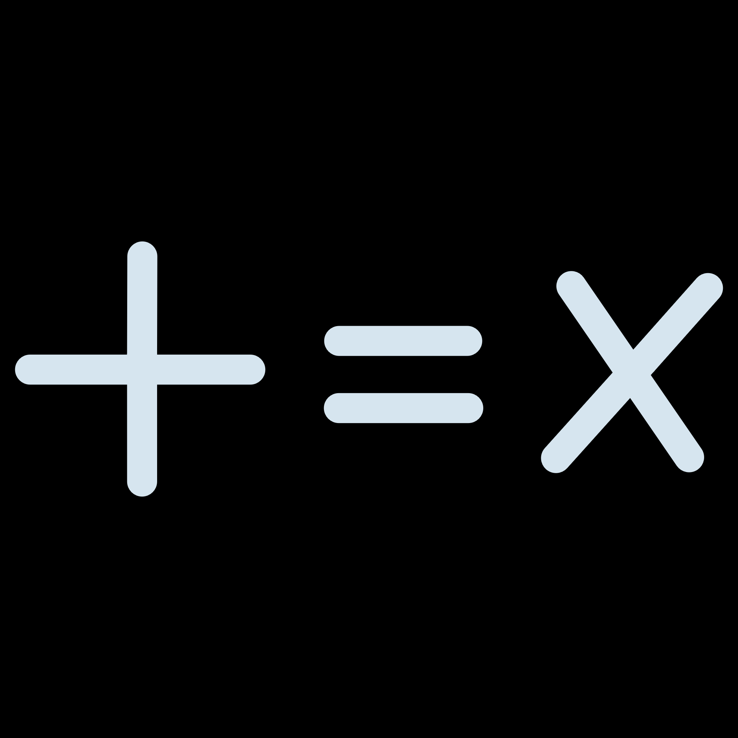


Process Flow / Use-Case Diagram
Amazon Bedrock
User Input
Sarvam AI
AWS Lambda
Output
The system transforms voice queries into actionable eligibility results through a seamless AI-powered pipeline, ensuring citizens receive accurate, personalized guidance in their native language.

Slide 6
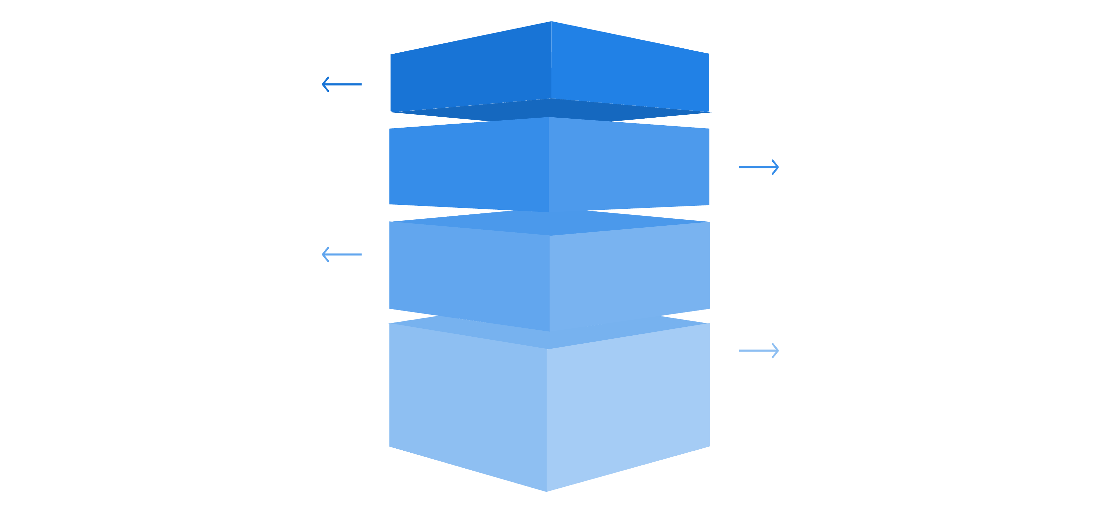
Architecture Diagram
Interface
Web / WhatsApp · Sarvam AI
Application
API Gateway · Lambda
Intelligence
Bedrock · Knowledge Bases
Data
S3 · DynamoDB
This diagram illustrates the logical flow of the system, from user interaction to data storage, highlighting key technologies at each stage.

Slide 7






Technologies to be Used
AI/ML
Storage
Amazon Bedrock, LangChain, LangGraph.
Amazon S3, Amazon DynamoDB.
Indic Voice
API/Integration
Sarvam AI (STT/TTS Bengali).
AWS API Gateway, Python.
WhatsApp Integration
Monitoring
Twilio for seamless WhatsApp messaging and communication.
AWS CloudWatch.
Compute
AWS Lambda (Serverless).

Slide 8


Estimated Implementation Cost
Target: 10,000 users/month
$55(₹4,600)
$75(₹6,300)
Amazon Bedrock
Sarvam AI API
Claude Haiku, 10M tokens/month.
Bengali Voice, ₹30/hr STT + ₹20/10k TTS.
$17(₹1,400)
$42(₹3,500)
AWS Infrastructure + Lambda
+ DynamoDB + S3 + CloudWatch
Twilio WhatsApp
₹0.35/conversation
Total: ~$200/month
Cost per Citizen: Approx. ₹2/month, delivering a value return of ₹45-50 per saved office visit.
Cost Optimization Plan:
Phase 2: Switch to Indian WhatsApp provider → Save 50% ($21/month) Optimized Total: $168/month (₹1.40/user)

Slide 9
Impact & Roadmap
Impact
Roadmap
18/20 found readiness score helpful
Average 2.3 documents missing per user
90% would use before office visit
Estimated savings: ₹90-130 per user in travel costs
10 days faster application process
01
Phase 1(MVP)
Single scheme (Lakshmir Bhandar) with production-ready architecture
Proof of concept with 20 pilot users
Potential at Scale (10K users): ₹9-13 lakh saved in travel costs annually
02
Phase 2(3 months)
Expand to 4 schemes (Swasthya Sathi, Ration, Yuva Sathi)Integration with Digilocker for automated document verification.
03
Phase 3 (1 year)
Scaling to all 20+ WB welfare schemes and tribal dialects (Santali, etc.).

Slide 10

Closing Statement
"West Bengal does not lack welfare schemes; it lacks accessible verification. WB Digital Sahayak ensures citizens approach government offices prepared, informed, and empowered. We are turning voice into a tool for social justice."

Slide 11
